Slide 1


Hotel Management System
BCA Sixth Semester Project Mid-Defense

Slide 2
Introduction
Hotel Management System is the Desktop base application basically designed for Hotel.
These major operations include in this system are:-
Front-desk operations (customer management, room allocation)
Accommodation (Hotel room management).
Staff record Management.
Accounts Receivable &Payable.
Driver Record Management.
Guest Record Management.

Slide 3
Problem of Statement
Difficulty in the maintenance of records because of using traditional recording technique
Time-consuming
Editing data becomes a tedious job
No security of data
Mistakes occurring in the Calculation of funds
Lack of efficiency
Data redundancy
Data inconsistency
Incidence of Fraud

Slide 4
Objectives
Adequate Record Keeping
Reduced Incidence of Fraud
Reduced Time Consumption
Removal of Data Redundancy.
Data Consistency
Keeping a tack on guest check-in check-out status.

Slide 5
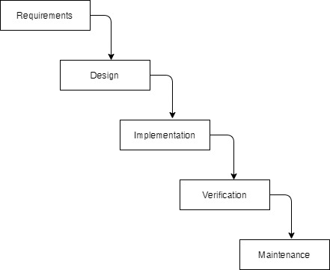
Development methodology

Slide 6
Requirement Analysis
1. Functional requirement
2.Non functional requirement

Slide 7
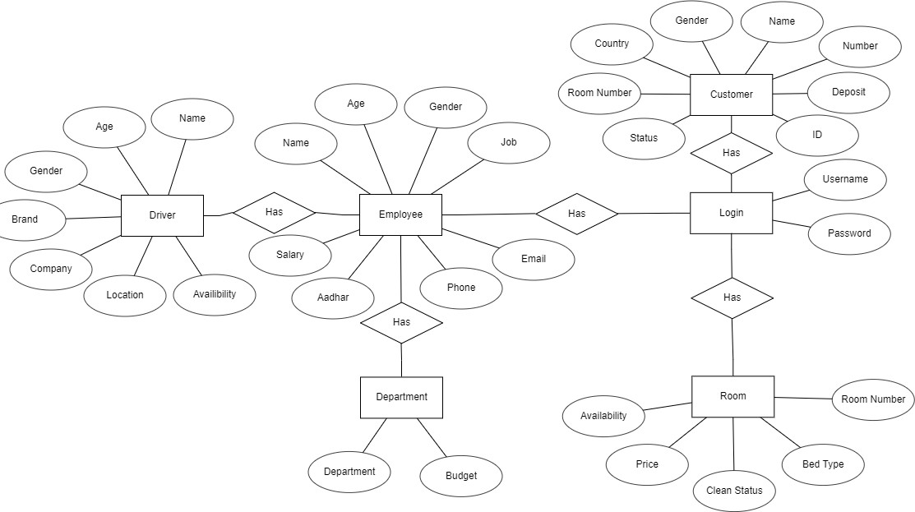
Data modeling

Slide 8
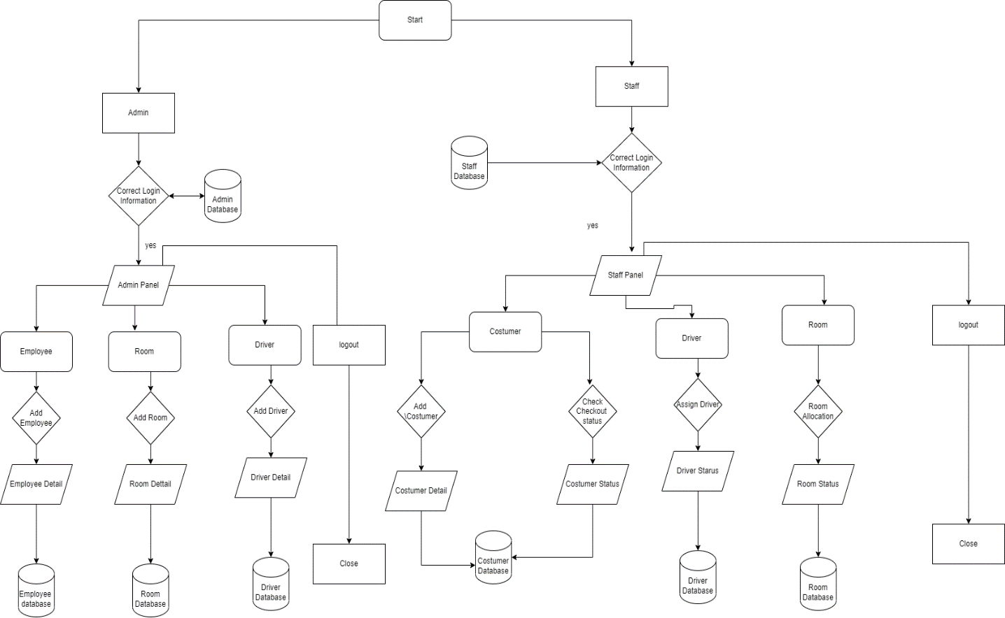
Process model

Slide 9
Implementing tools
Front End Tools
Java Swing:
Back End Tool
MYSQL:

Slide 10
Conclusion

